Slide 1
Group 4
Nathan Cunanan, Computer Engineering
Nathaniel Dunn, Electrical Engineering
Daniel Vicenti, Computer Engineering
Eric Watson, Computer/Electrical Engineering
Adam Bush, Computer Engineering
Notes:
Nathan

Slide 2
Project Motivation and Goals
An affordable gunshot detector for public safety, law enforcement, and military applications.
An audio-recording device that can be attached to either a building or vehicle.
A program that can be downloaded and used on a host computer, and detects and locates gunshots in audio from the device.
Notes:
Daniel: While we may not always agree upon it, gun violence is a major issue in our country. Regardless of stance, most people can probably agree that a technological solution to this issue is a valid solution. Project Minuteman aims to create an affordable gunshot detector designed for public-safety, law-enforcement, and military applications. It will consist of a primary sensor device with a microcontroller, connected to a host computer running a companion software.

Slide 3
Project Overview
The project involves creating a gunshot detector using microphones and a companion program to analyze the audio from the device.
Audio is scanned for events exceeding 130 dB in magnitude.
If an audio event exceeding that threshold is detected, a neural network classifies whether or not the audio is a gunshot.
If classified as a gunshot, multilateration is used to locate where the gun was fired with respect to the device.
The program sends data in an alert.
Notes:
Daniel: Our project involves a primary device that collects audio for a companion program on a host computer. The program first examines the maximum magnitude of the audio waveform. Unsuppressed gunshots generate audio exceeding 130 dB, so any audio event exceeding that number is worth examining for gunshots. From there, a neural network will classify whether or not the audio contains a gunshot. If it is confirmed, then multilateration is used to determine the location of the gunshot, which is then reported along with an alert to contacts set by the user.

Slide 4
Requirements and Specifications
Has a maximum range of: | 250 | Meters
Locate gunshots to within: | 5 | Meters
Can detect a gunshot with greater than: | 90% | Accuracy
Can send an alert within: | 2.5 | Seconds
Costs about: | 350 | USD
Device dimensions: | 100 x 100 x 50 | Centimeters
Device weight: | 5 | Pounds
For audio sensors, has at least: | 5 | Microphones
For location, has at least: | 1 | GPS
For multilateration, has at least: | 1 | Thermometer
Notes:
Daniel: Our requirements for this project is to detect gunshots within at least 250 meters radius around the device, locate them within 5 meters of their actual location, achieve a detection accuracy of 90% or greater, report a gunshot within 2.5 seconds of the event, and to have a cost of about 350 USD. The device has 5 microphones with the fifth microphone situated to account for elevation in the multilateration measurements. A thermometer is used to account for environmental influences on the sounds, and a GPS locator is used to convert the location of the gunshot to GPS coordinates with respect to the device.

Slide 5
Prior Works
A 2013-2014 Senior Design group, Project GLASS, worked on a similar task, though they failed to meet their original goals. Insights gained from their process include:
Attempts to do on-chip processing failed, requiring a host computer to intervene. Our design starts at this stage
Their distance and direction detection were fairly imprecise. We use multiple samples in one gunshot’s recording window to improve this
Their display format was insufficient - timestamped text output. We will use our results to display satellite-mapped positional data to the user
Notes:
Adam and Nathaniel

Slide 6
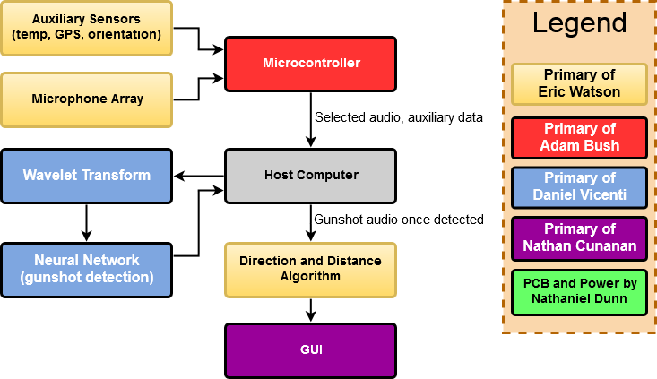
Project Block Diagram
Notes:
Adam and Nathan

Slide 7
Design Choices
USB will be used instead of wireless alternatives both to reduce latency and as a backup if noise level detection at the MCU is insufficient to mark potential gunshots, due to its higher bandwidth
Multilateration over triangulation, to be covered in detail shortly
Machine learning over algorithmic analysis, as the latter is more intricate, less configurable, and unrealistic in dynamic, uncontrolled environments
Google Maps Satellite View was chosen as the best and most accessible method for presenting easily discernible output to a user
Notes:
Adam and Nathaniel

Slide 8
Gunshot Sound Signature Background
Mostly in the 100-10,000 Hz range
The muzzle blast is the distinctive and loudest portion of the resultant sound, and the events of interest - the early peak and the resultant drop in pressure - take place in a window of 2-3 milliseconds
The beginning of the muzzle blast, the peak of the muzzle blast, and the lowest pressure point following that peak are significant, always-present markers we will use in comparisons between the different microphones
Speed of sound = 331.3 + .606 * Temp(°C) meters/second, for a potential deviation of ~6% here in Orlando, based on the weather
Notes:
Adam and Eric

Slide 9
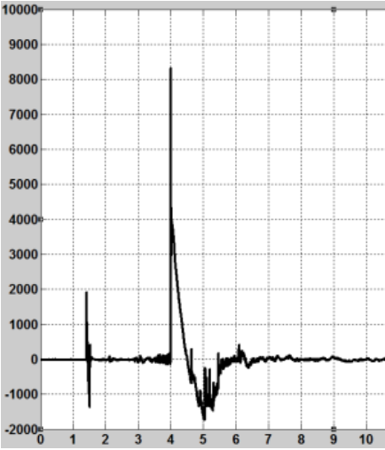
Gunshot Audio Waveform Example
Pressure (Pascals) vs time (ms), from reference [2]
Notes:
Adam and Eric

Slide 10
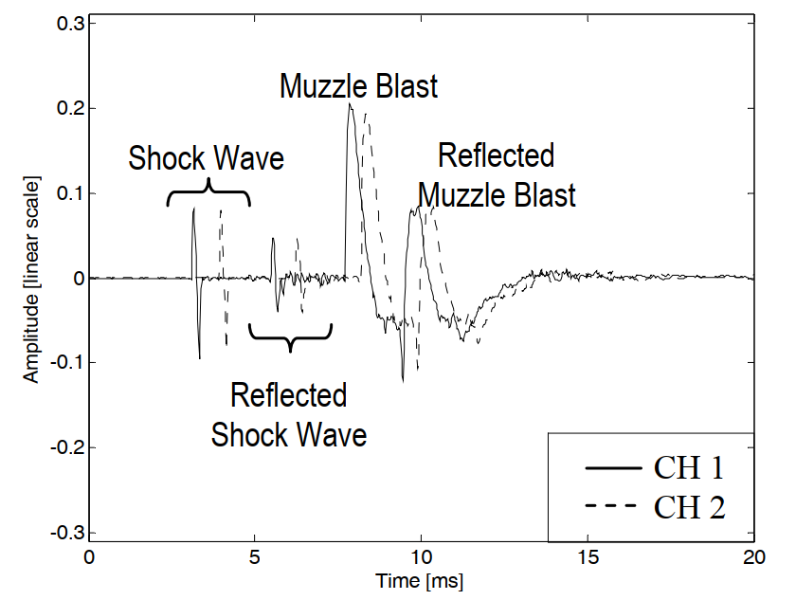
Gunshot Audio Two-Channel Example
For supersonic bullets traveling near a microphone, a shock wave may be evident in the recording
Reflected muzzle blast is shown in a very clean environment
Source: reference [3]
Notes:
Adam and Eric

Slide 11
Triangulation
Location technique that utilizes trigonometry to get the position of a sound source using angle measurements
2D triangulation utilizes two arrays with three microphones. Each array is shaped as an equilateral triangle
3D triangulation utilizes two arrays with four microphones. Each array is shaped as an equilateral pyramid
Using the angle measured and position of each array, a triangle can be formed between both arrays to get the position of the sound source
Direction of the sound wave can be considered a straight line if microphones are close together and the sound source is far away
Notes:
Eric

Slide 12
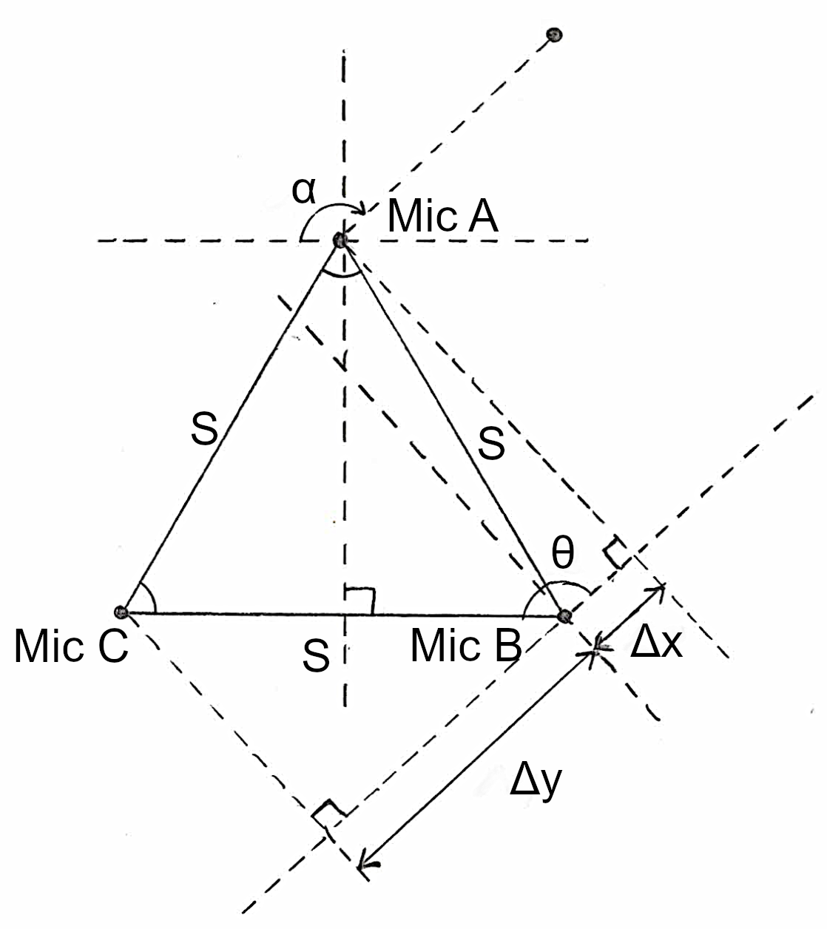
Triangulation
The distance of Δx is the time difference between the first and second microphone that picked up the sound (t_{B} - t_{A}) multiplied by the speed of sound constant (C), which is dependent on temperature, so a thermometer is required for temperature measurement.
The angle of θ can be calculated using the inverse cosine of Δx divided by the distance between the microphones (S), which is used to solve for the angle of α.
Notes:
Eric

Slide 13
Triangulation
The distance of Δy is the time difference between the second and third microphone that picks up the sound (t_{C} - t_{B}) multiplied by the speed of sound constant (C).
Δy can also be calculated by having the side of the array multiplied by the cosine of the supplementary angle of α.
By comparing both equations of Δy, this can be used to determine error in the angle calculated.
Notes:
Eric

Slide 14
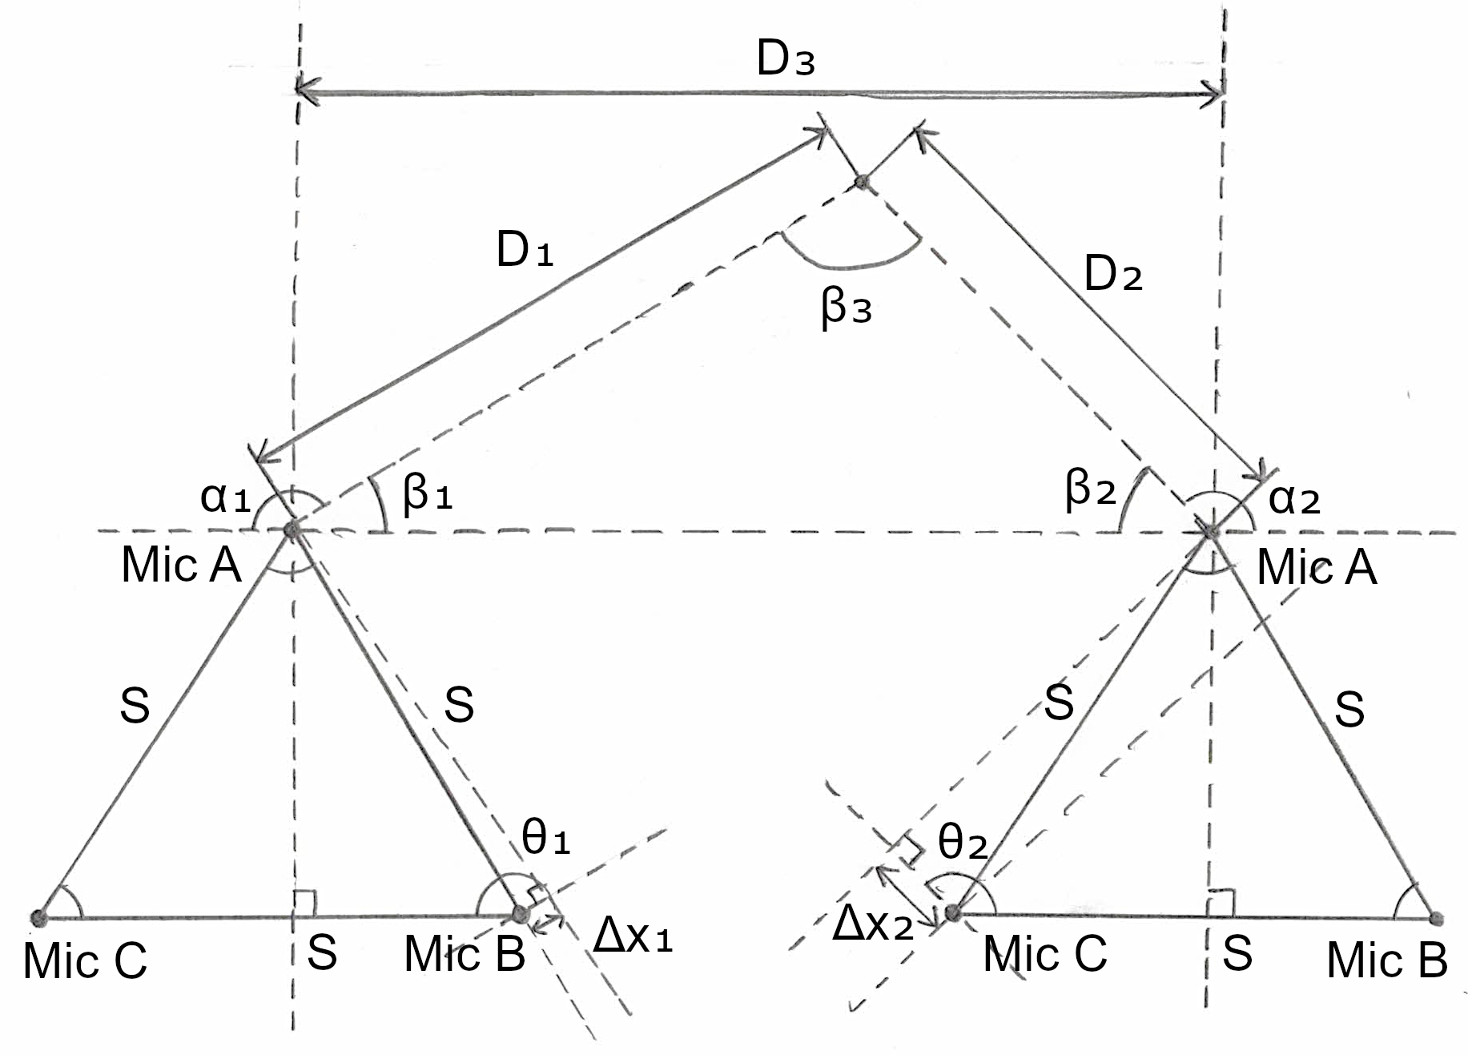
Triangulation
Each array would have a compass to provide its relative orientation and a GPS module to provide its position.
ß₁ and ß₂ are the supplementary angles of α₁ and α₂, which can be used to solve for the angle of ß₃.
D₃ is the known distance between two microphone arrays.
Knowing the values of ß and the distance between the two arrays, the law of sines can be used to solve the distance to the source from either array.
Notes:
Eric

Slide 15
Multilateration
Location technique that measures the time distance of arrival (TDOA) of an energy wave (acoustic source) with a known propagation speed (speed of sound) between two or more receivers (microphones), which forms half of a hyperbola.
2D multilateration utilizes three microphones that can be arranged in any shape and obtains the position of the sound source from the intersection of two hyperbolas.
3D multilateration works the same, but utilizes a fourth microphone and obtains the position of the sound source from the intersection of three hyperbolas.
Notes:
Eirc

Slide 16
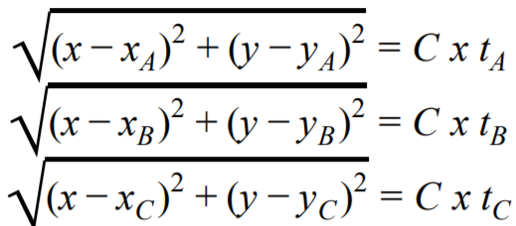
Multilateration
For 2D multilateration, the distance formula can be used for each of the three microphones in the array, which is shown on the right, where x_{i} and y_{i} are the relative location of each microphone from the origin.
The time difference between the first microphone to receive the sound and the second and third microphone can be used to form two equations that would solve two unknowns, which can then be used to get the source of the sound.
However, since the equations are not linear, solving them would be computationally expensive, so the equations would have to be linearized, but can only be done for 3D multilateration.
Notes:
Eric

Slide 17
Multilateration
For 3D multilateration, four microphones or more are used, and solve for the components of x, y, and z. The difference between all microphones would then give three equations that will solve for three unknowns, as shown below.
The equation was linearized by setting the TDOA of microphone “i” and the first microphone “0” equal to the TDOA of microphone “i” and the second microphone “1”, which was used to remove the square root. The linear form is given below:
Notes:
Eric

Slide 18
Multilateration
Utilizing the linear form, Gaussian elimination can be used, which requires a fifth microphone to solve for the values of x, y, and z.
Compared to triangulation, multilateration would only require one array to determine the position of the sound source instead of two arrays, reducing the number of components needed. This also allows the system to be mobile and also reduces the cable management needed between two microphone arrays if triangulation is used.
Notes:
Eric

Slide 19
HARDWARE
Notes:
Nathaniel, Eric, and Adam

Slide 20
Hardware - Choice
Power Adapter | 12VDC Power Adapter Supply
Switching Regulator | LTM4622A, LMR23610ADDA
Power Inverter | MAX1044
Microphone | CMC-6035-130T
Temperature Probe | DS18B20
Global Positioning | NEO-6 u-blox 6 GPS Modules
Gyroscope, Accelerometer, and Geomagnetic Sensor | Bosch BNO055
Amplifier | TL072
Microcontroller | AT91SAM3X8E
ADC | ADS8586SIPM
Notes:
Nathaniel

Slide 21
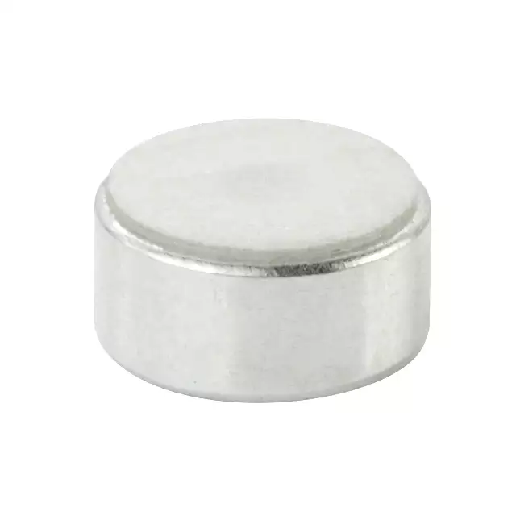
Microphone - CUI CMC-6035-130T
Microphone is used to determine the position of the sound source and used to send samples to the neural network
Has an omnidirectional polar pattern
Has a high signal to noise ratio of 70 dB
Has a sensitivity of -42 dB
Has a maximum input of 130 dB SPL
Has a frequency range of 100 Hz to 20 kHz
Has a flat frequency response
Notes:
Eric

Slide 22
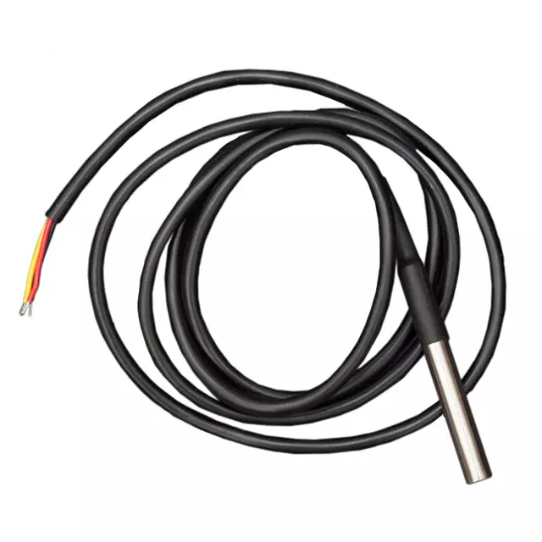
Temperature Sensor - Maxim Integrated DS18B20
Used to measure temperature of the environment for the speed of sound calculation for the microphone array
Has a waterproof casing
Has a temperature accuracy of ±0.5℃
Has a temperature range of -55℃ to 125℃
Has a voltage range of 3V to 5.5V
Has a serial digital output
Notes:
Eric

Slide 23
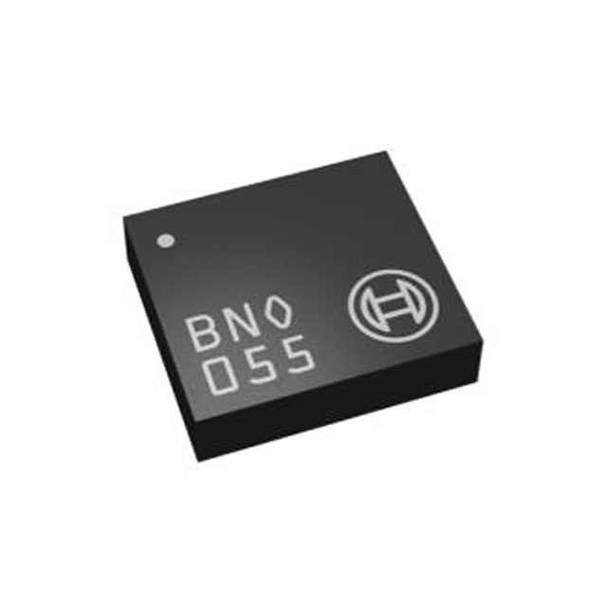
Compass Module - Bosch BNO055
Used to provide the orientation of the microphone array
Integrated accelerometer, gyroscope, and magnetometer provides absolute orientation
Has a max update frequency of 400 Hz
Has an operating temperature of -40℃ to 85℃
Has a voltage range of 1.7V to 3.6V
Has a flexible serial digital output
Notes:
Eric

Slide 24
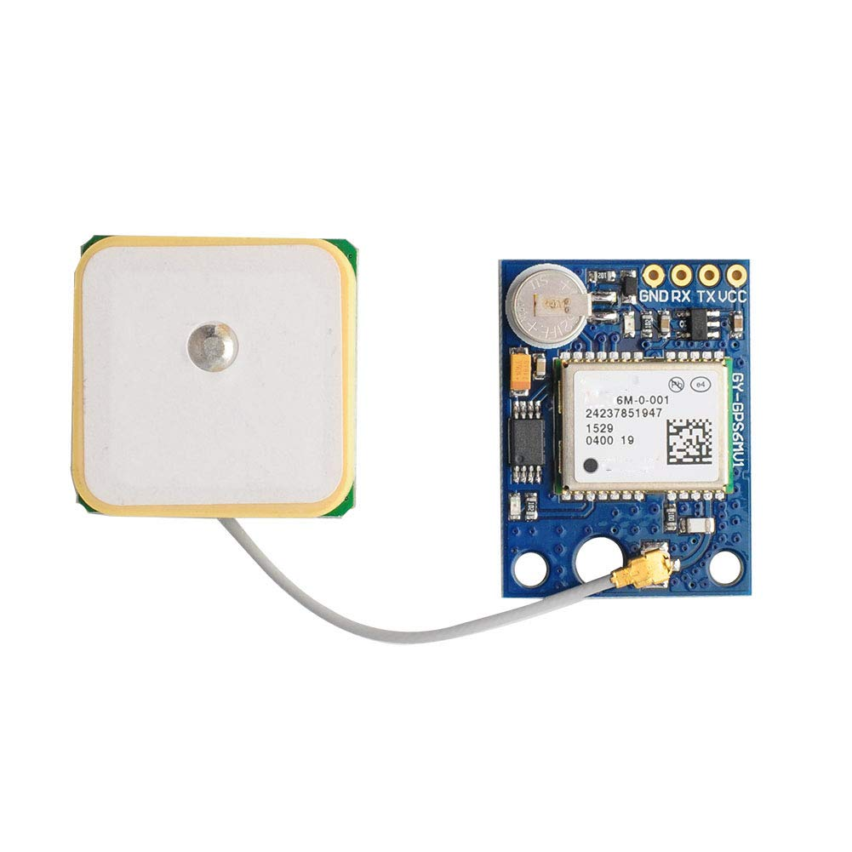
GPS Module - u-blox NEO 6M
Used to provide the position of the microphone array
Has a cold start time of 27 seconds, allowing the microphone array to be deployed quickly
Has a horizontal accuracy of 2.5 meters
Has a maximum supply voltage of 3.6V
Has a UART / I2C digital output
Notes:
Eric

Slide 25
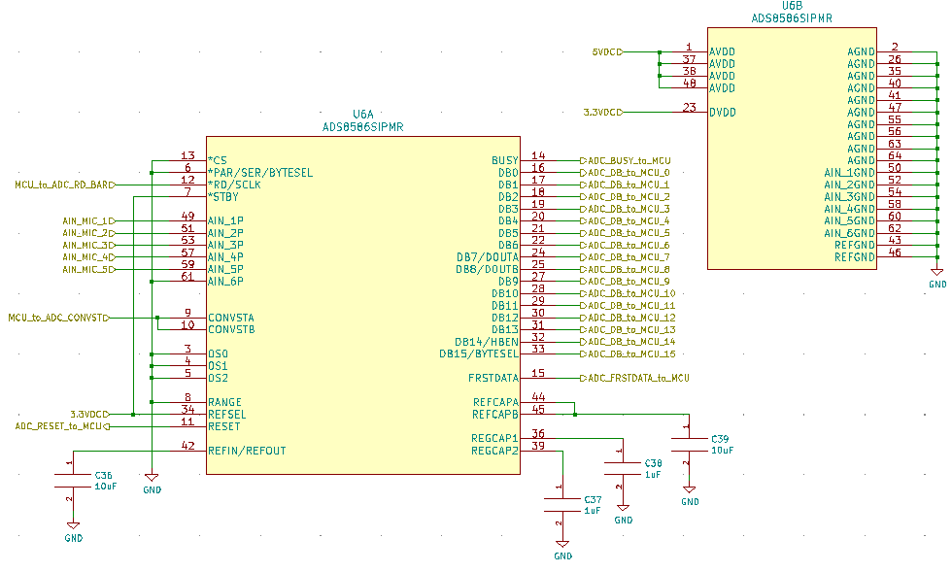
ADC - ADS8586S
Need an analog to digital converter capable of intaking and converting multiple analog signals at once.
16-bit resolution
6-channel
High-speed
Simultaneous-sampling
Parallel output
Single-end input
Notes:
Nathaniel

Slide 26
MCU - Atmel ATSAM3X8E
Low requirements: audio sampling in the 10s of KHz, USB and UART I/O
Chosen partially due to group familiarity and abundance of design resources as the MCU of the Arduino Due
$7 price tag (5,000 unit price point)
84MHz core clock, 96kB SRAM
DMA controller for all I/O:
Parallel GPIO for ADC interfacing
UART for GPS module
UART for gyroscope/accelerometer
1-wire UART interface to temperature probe
Notes:
Adam and Nathaniel

Slide 27
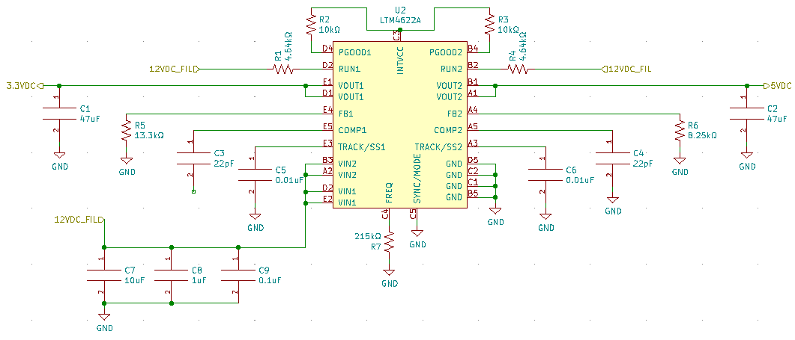
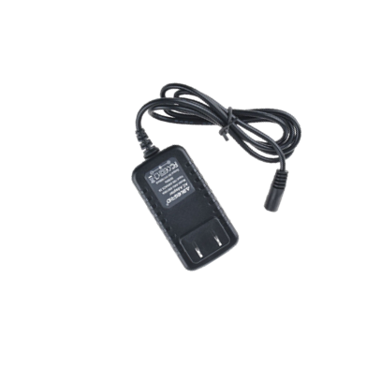
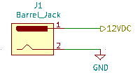
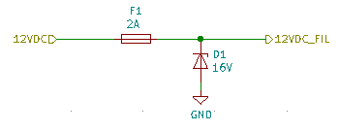
Power Supply - LMT4622A
AC wall adapter inputs 12V DC to the power supply. This regulates to two voltages, 3.3V DC and 5V DC.
Dual output voltage
High power efficiency
91% 5V DC
89% 3.3V DC
Notes:
Nathaniel

Slide 28
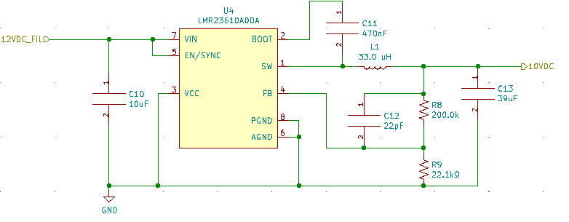
Secondary Power Supply - LMR23610
The 12VDC is regulated down to 10VDC. This is then used for the rails on the TL072.
High power efficiency 95.6%
Cheap

Slide 29
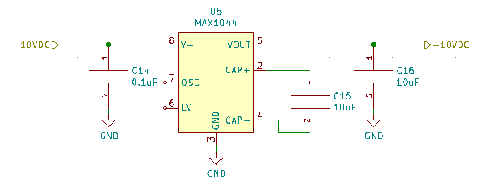
Power Inverter - MAX1044
The MAX1044 will be used to invert the 10VDC to a -10VDC for the rails on the operation amplifiers.
High output efficiency at 98.8%
Easy to implement
Notes:
Nathaneil

Slide 30
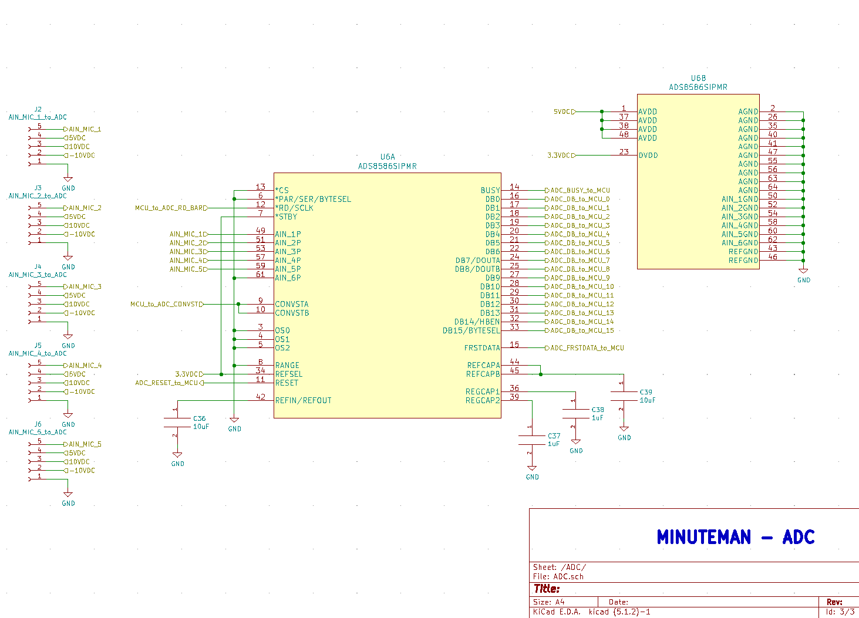
Notes:
Nathaniel

Slide 31
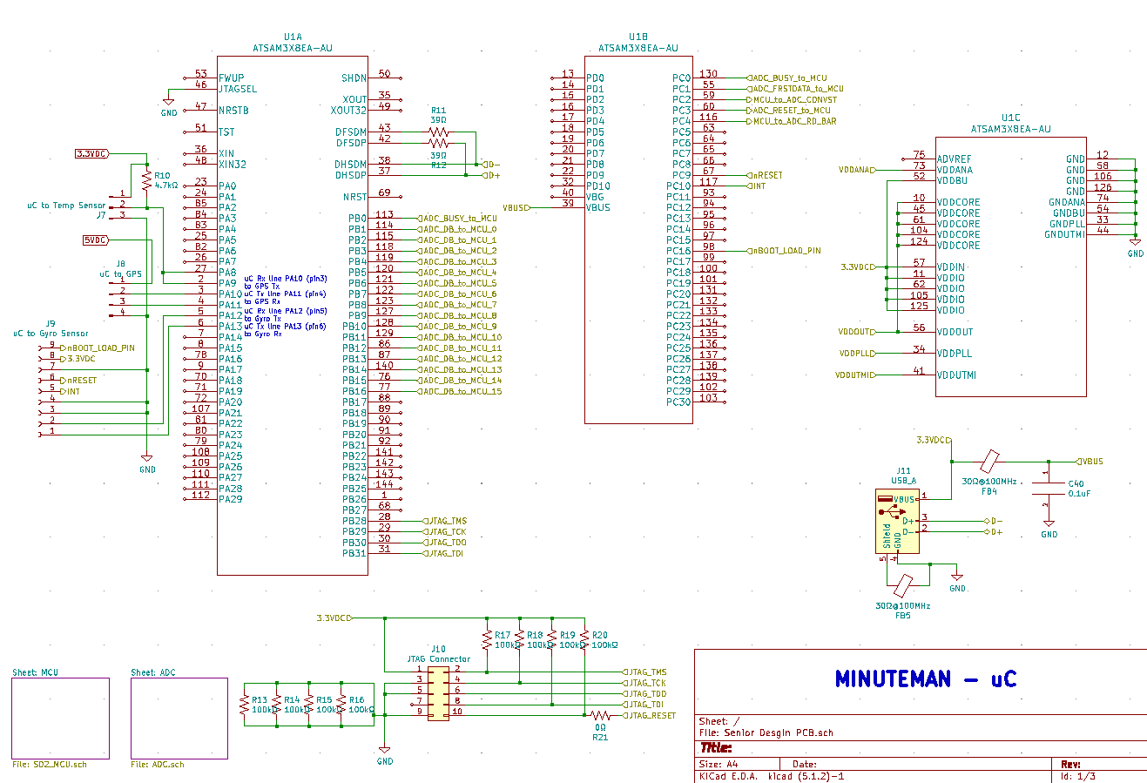
Notes:
Nathaniel

Slide 32
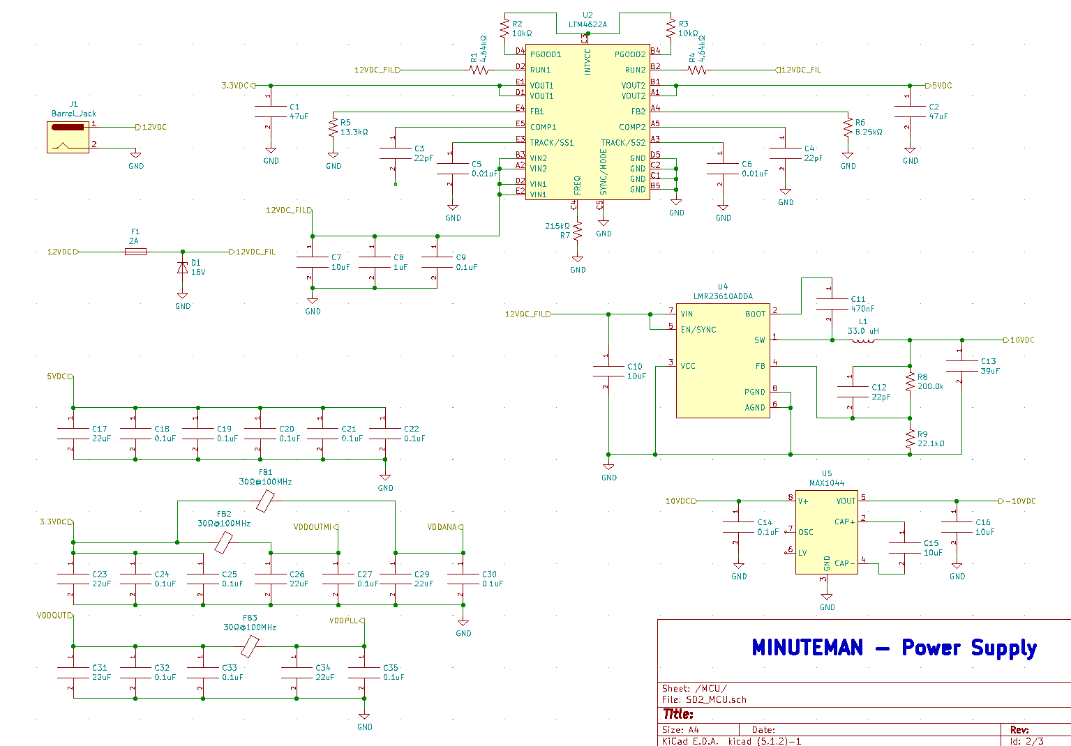
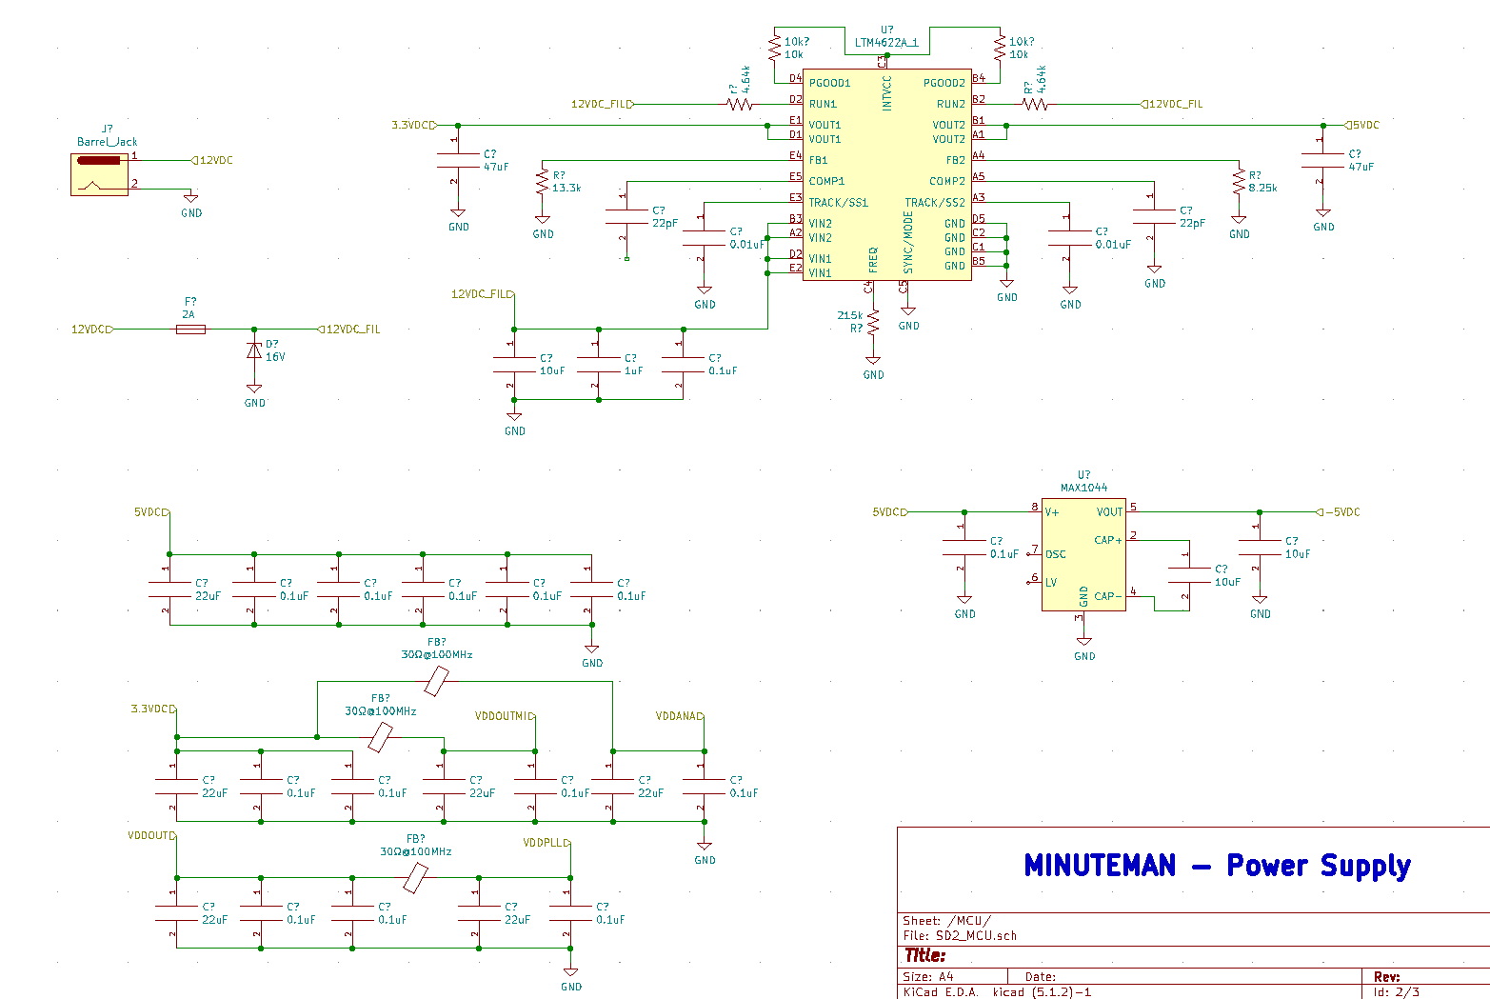
Notes:
Nathaniel

Slide 33
SOFTWARE
Notes:
Daniel, Nathan, and Eric

Slide 34
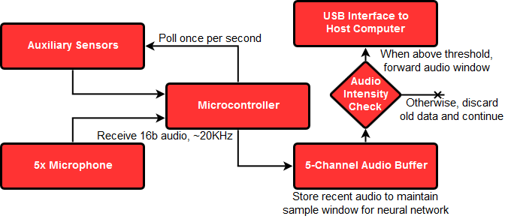
MCU Data Flow - Overview
Occasionally, approximately once per second, collect and forward positional, orientational, and temperature data to host
Target output is a ~10ms window of audio centered around a high-volume event - a potential gunshot
Prior audio data is stored to capture events other than the muzzle blast itself
Notes:
Adam and Daniel

Slide 35
MCU Data Flow - Audio Forwarding
Continually store the previous 5ms of audio in a circular buffer
Test one audio channel for high volume. If found, go to step 3
Capture the following 5ms of audio to serve as the second half of the recording, and begin forwarding all data to the host
After completion, continue recording to circular buffer, but pause detection for 20ms to ignore reflected duplicate events
Notes:
Adam and Daniel

Slide 36
Machine Learning Classification
Audio classification through machine learning is used to confirm the presence of a gunshot in audio that exceeds the 130 dB threshold.
The audio file is run through a wavelet transform algorithm to obtain an array of usable data for classification.
A convolutional neural network can be trained to achieve an extremely high accuracy in classification.
Notes:
Daniel: Once audio exceeds the threshold we established, we can use wavelet transform to generate an array of coefficients with respect to frequency scales. This is then passed through a convolutional neural network for classification.

Slide 37
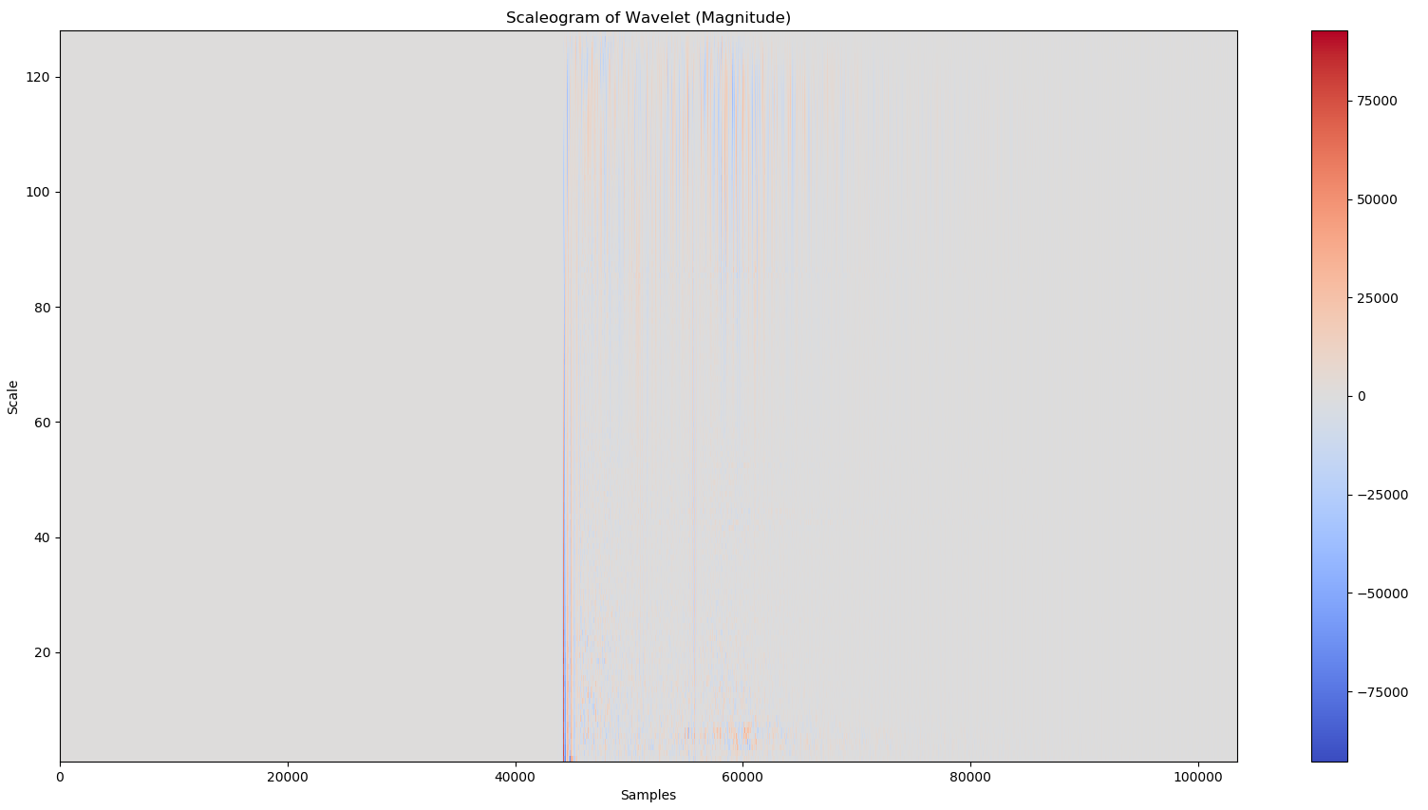
Notes:
Daniel: This displays a scaleogram of a .wav file containing the audio of a gunshot. It might be hard to see, but the colors in the center represent the audio that we wish to observe. Each pixel’s color represents the waveform magnitude at that time, and it’s location with respect to the scale represents it’s frequency. The higher the scale, the lower the frequency but the more the data is represented with respect to time, and vice versa.

Slide 38
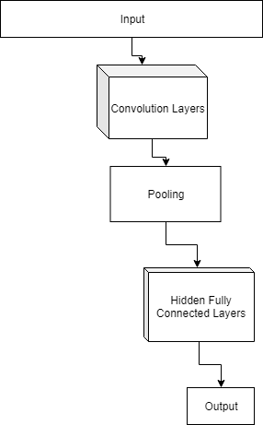
CNN Architecture and Data
Designing the architecture for a convolutional neural network requires a degree of intuition and trial and error. Therefore, one will be developed as the software is further progressed.
A dataset for training and testing will be developed by gathering audio samples of gunshots at a private gun range.
Notes:
Daniel: The image to the right on this slide represents a simple convolutional neural network architecture. A more complex network will be developed for project minuteman. A dataset will be developed by recording audio samples of gunshots at different locations at a private gun range. This dataset will be used for training and testing the CNN.

Slide 39
CNN Training and Testing
In order to produce a neural network that works, it will need to be trained.
Training is handled by a separate program which uses backpropagation to adjust neuron weights.
A final test will determine the accuracy in a situation with samples that were not used in training.
Notes:
Daniel: In order to develop an effective neural network it will require some training on a program separate to the companion program prior to use. Training will use backpropagation to correct the weights of each neuron based on the error of the outputs, and each connection. A final test will be used to calculate effective accuracy with data the network did not encounter in training.

Slide 40
CNN Implementation
Once a network is generated in training, the model of the network, along with the weight values, can be saved to a .h5 file.
The companion program for the final project will read this file and load it when it is needed for classification.
No training or testing is required at this point. The network simply needs to make predictions based on the input data, without needing to train or compute testing accuracy.
Notes:
Daniel: Our CNN can be implemented by saving the final model, after training and testing, to a .h5 file. This file will be loaded into the primary companion program before release. This can then be used to predict the class of a given wavelet array. Future updates can be easily applied, regardless of changes to the model or the weights, by simply updating the designated .h5 file.

Slide 41
User Interface
A software program that a user can use in a computer to run the Project Minuteman system.
The main programming language used in making the interface will be C or C++, using Microsoft Visual Studio.
Main source of presentation for relaying information needed by the user like:
The location of the gunshots
The distance of the gunshots
Alerts when a gunshot is found, none when no gunshot pops up
Timestamps on when the shots are fired
The type of firearm used
Notes:
Nathan

Slide 42
User Interface Process
The software is downloadable using an installer from the group’s website.
To be able to create an account for each user and log in and log out with ease as the user navigates the software.
Convenience of being able to run in the background while the software is acquiring the necessary information to display in the interface.
If the sample detects a shockwave, it will confirm the event which will determine the type of firearm that is being used.
Notes:
Nathan

Slide 43
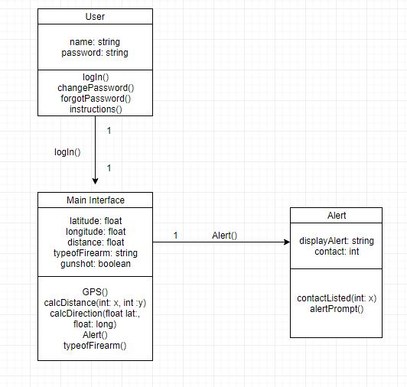
UML
Notes:
Nathan

Slide 44
Work Distribution
 | PCB Design | Power | Embedded Prog. | Sensor Config | Data Processing | GUI
Nathan Cunanan, CpE |  |  |  |  | S | P
Nathaniel Dunn, EE | P | P |  | S
Daniel Vicenti, CpE |  |  |  |  | P | S
Eric Watson, CpE+EE |  |  | S | P | S
Adam Bush, CpE | S | S | P | S
Primary, Secondary
Notes:
Adam and Nathan

Slide 45
Difficulties
IC integration can only really be tested when PCB is printed
Complex programming in getting a structure for the interface
Complexity of data - loading an audio file into a usable format with wavelet transform.
The large amounts of data necessary for neural network training and testing.
The intuitive complexity of designing neural network architecture.

Slide 46
Project Budget and Financing
Material/Part | Quantity | Price ($) | Total ($) | Material/Part | Quantity | Price ($) | Total ($)
Arduino Due | 1 | 48.00 | 48.00 | Gyroscope | 1 | 34.34 | 34.34
MCU | 1 | 11.54 | 11.54 | GPS Module | 1 | 15.99 | 15.99
Power Adapter | 1 | 2.99 | 2.99 | Temp Probe | 1 | 8.20 | 8.20
V Regulator | 2 | 17.31 | 34.62 | Amplifier | 25 | 0.15 | 4.20
Inverter | 2 | 1.43 | 2.86 | PCB Costs | 5 | 20.00 | 100.00
Microphone | 12 | 2.12 | 25.44 | Misc. | N/A | 50.00 | 50.00
Total | $338.18
Notes:
Adam And nathan
MAX is a inverter
CMC microphone
BNO gyroscope
Maxim temp probe
TL amplifier

Slide 47
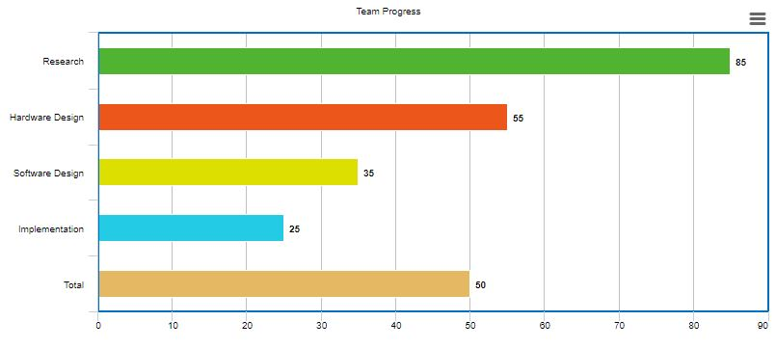
Team Progress
Notes:
Nathan

Slide 48
Strategies for Completion
Weekly meetings to be able to get each other updated in building the system
Openly talk over Discord to talk about potential changes to the project and use Trello to lay down specific deadlines or milestones for the group
Be accountable for one another so that no one gets lost in the process
Notes:
Nathan

Slide 49
References
[1] Gunshot acoustics primer
http://www.montana.edu/rmaher/publications/maher_aac_0406.pdf
[2] Gunshot pressure vs time graphs
http://www.montana.edu/rmaher/publications/routh_maher_asa_0516.pdf
[3] Gunshot sound signatures
http://www.montana.edu/rmaher/publications/maher_aesconf_0608_1-8.pdf

Slide 50
Questions?

